Slide 1
Lab 1 Introduction to MATLAB
Notes:
各位同学大家好，今天我们要开启信号与系统的第一个实验了。我们知道工欲善其事，必先利其器。那么在这次课中，就让我们先来熟悉下我们的课程工具Matlab吧。

Slide 2
Objectives
Work with MATLAB 2020b.
Mast the plotting skills.
The representation of elementary signals.
The operation of signals with MATLAB.
Familiar with the program structure.
Notes:
我们这学期的信号与系统实验课主要是基于MATLAB的。
那么我们本节课主要目标有：
能利用MATLAB完成一些基本的操作，建议使用的MATLAB版本为2019b，低版本的MATLAB在使用上会存在一定的差异。如果同学们使用低版本的MATLAB运行本教程中的例子时出现报错，可以使用help命令来查看函数的详细使用方法。
可视化数据是MATLAB的一个特点，因此画图的技巧对于MATLAB来说就是一个比较重要的环节。希望同学们在后面的实验中不要止步于把图画出来就好了，可以考虑下如何通过缩放、线条、色彩等作图手段将你的结论表达清楚。
MATLAB本身的功能十分强大，应用的领域也相当的广泛，而我们的实验课主要是服务于信号与系统的分析，因此对于我们来说掌握信号的表达及操作也是必不可少的。
最后我们会熟悉一下我们可能会用到的MATLAB中的几种编程结构，以便于同学们之后可以有效的简化自己的代码。对于已经学过其它编程语言的同学来说了，会比较熟悉这部分的内容，主要需要注意下各种结构在MATLAB中的格式问题。

Slide 3
MATLAB
Performing mathematical computations and signal processing.
Analyzing and visualizing data (excellent graphics tools).
Modeling physical systems and phenomena.
Testing engineering designs.
The fundamental data type is the array and the basic building block is the matrix.
数值分析，矩阵计算、数据可视化
Notes:
首先来了解一下什么是MATLAB
MATLAB是matrix和laboratory两个词的组合，也就是矩阵实验室，从其名字我们不难看出MATLAB以矩阵为基本数据单位。它是一个集数值分析、矩阵计算、数据可视化、系统建模和仿真等诸多功能于一身的软件，主要应用于工程计算、控制设计、信号处理、图像处理等领域。

Slide 4
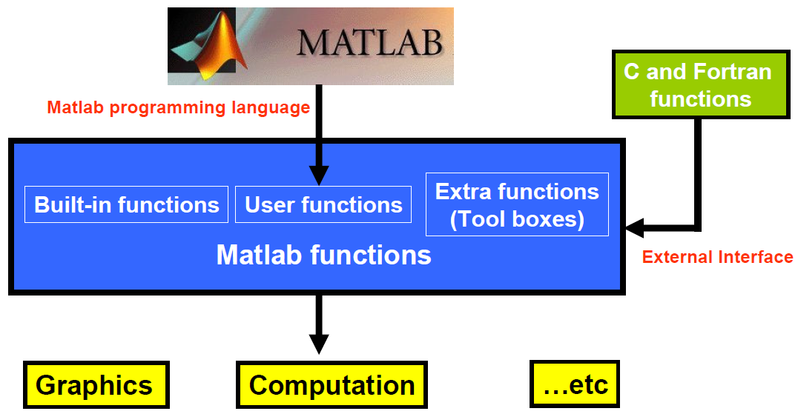
Structure of MATLAB
Notes:
如图显示的是MATLAB的结构图。
从函数的角度讲，MATLAB主要包含3个来源：Built-in functions是MATLAB自带函数，比如我们的画图函数，部分图形的创建函数等。我们也可以根据需要、使用MATLAB编程语言创建的函数，也就是User functions。另外MATLAB也提供了和c语言、Fortran语言等的接口，以提供相应的函数功能。这部分内容我们主要掌握使用方法即可。
功能上如前面所说MATLAB提供了，数值计算、数据可视化等功能。

Slide 5
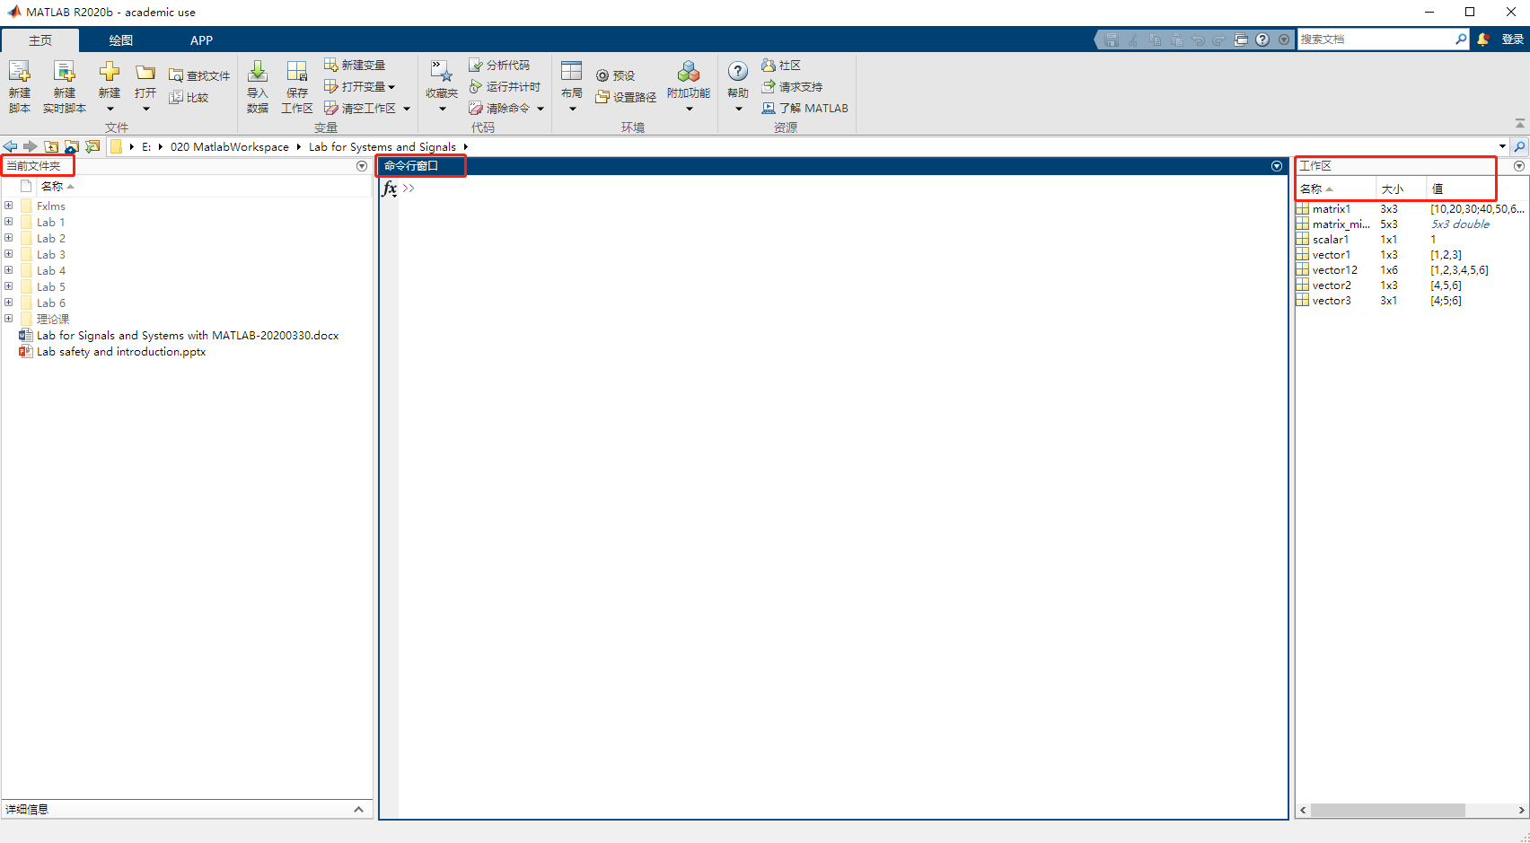
e.g.
Desktop of Matlab
Notes:
在MATLAB界面需要关注的区域包括：
命令行窗口：可以在此直接输入需要执行的命令，回车后当前命令被执行；
历史命令窗口：记录了已执行过的命令。有停靠和弹出两种模式，在布局中可更改相关设置。默认为弹出模式，在命令窗口中使用向上方向键可调出；
当前文件夹：当前的工作目录，新建的函数或脚本默认被保存在当前文件夹中。另外，在调用用户自定义函数时，需要将自定义函数放在当前文件夹中；
工作区：保存了当前的变量值，变量的值也可直接在工作区中进行修改。需要注意的是，在重新运行我们的代码之前，建议使用clear命令来清除工作区变量的值。

Slide 6
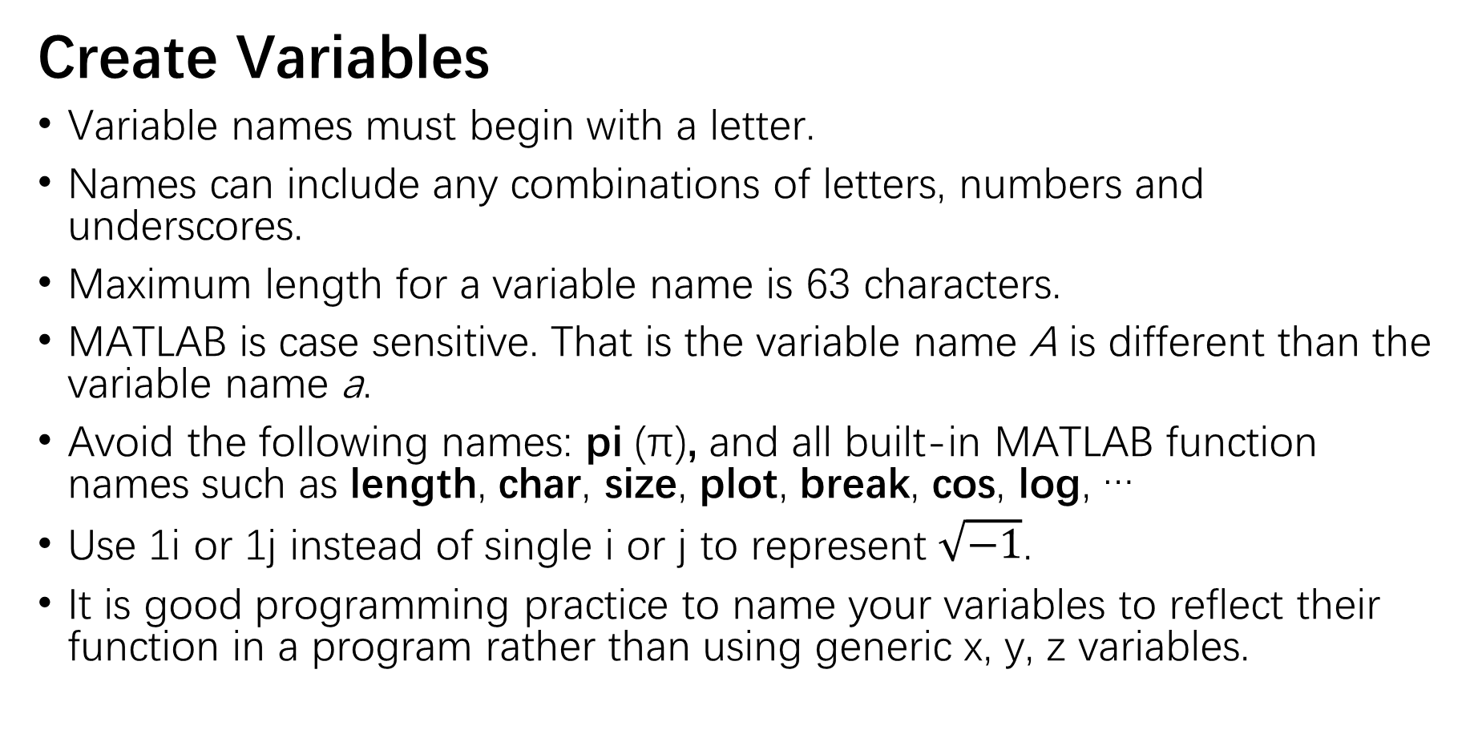
e.g.
Create Variables
Variable names must begin with a letter.
Names can include any combinations of letters, numbers and underscores.
Maximum length for a variable name is 63 characters.
MATLAB is case sensitive. That is the variable name A is different than the variable name a.
Avoid the following names: pi (π), and all built-in MATLAB function names such as length, char, size, plot, break, cos, log, …
Use 1i or 1j instead of single i or j to represent $\sqrt{−1}$.
It is good programming practice to name your variables to reflect their function in a program rather than using generic x, y, z variables.
Notes:
任何变量在MATLAB中都被视为一个N*M的数组，按照N和M取值的不同，形成了标量、向量、矩阵等（演示一下各类数组的创建）。
在MATLAB中创建向量只要在命令行窗口中输入变量名+等号+变量值即可。对应变量名需要遵循以下这些规则：

Slide 7
e.g.
Plotting
Plotting function:
plot(X, Y); plot(Y); plot(_, LineSpec); plot(X1, Y1,…Xn, Yn);
stem(X, Y); stem(Y); stem(_, LineSpec); stem(_, ’filled’);
fplot(f); fplot(f, [xmin, xmax]); fplot(xt, yt); fplot(_, LineSpec)
Subplot
subplot(m,n,p);
Label
title(‘text’);
xlabel(‘text’); ylabel(‘text’);
Range
axis([Xmin Xmax Ymin Ymax]);
Grid
grid on/off; grid minor;
[X,Y] = meshgrid(x,y);
1
2
3
4
Notes:
在接下去的课程中，我们可能会用到plot, stem, fplot三个绘图函数。其中plot用于连续图形的绘制，stem用于离散图形的绘制，fplot用于符号函数的绘制。
Subplot用于将一个图形空间进行分区，m为行数，n为列数，p为当前活动区域的索引；
可以使用下label，ylabel，title分别为图片标注上x轴名称，y轴名称及为图片命名；
axis用于为图片限定范围
grid用于为图片生成网格

Slide 8
Plotting-LineSpec
Line stytle:
- -- : -.
Marker
O + * . x s d ^ v > < p h
Color
y m c r g b w k
Notes:
MATLAB还提供了各种线条形状、符号形状及色彩用于绘图；同学们可以自行尝试，通过绘图来表达自己的思想。

Slide 9
Representation of Elementary Signal
Numerical method
Set a time range and sampling time interval
Generate the elementary signals with related function
Draw the signal with plot or stem
Symbolic method
Create symbolic objects with syms
Generate the elementary signals with related function
Draw the signal with fplot
Notes:
计算机只能对有限长、且离散的信号进行处理。连续信号的表示则要通过设置足够密集的取样点来实现的。在MATLAB中我们可以通过数值法和符号法两种方法来产生我们需要的信号。
使用数值法时，首先要确定取样时间段以及取样的间隔，生成信号后使用plot或者stem画出对应图形。
使用符号法时，需要先声明符号变量，生成信号使用fplot画出。

Slide 10
e.g.
Functions to Generate Elementary Signal
sin(x): returns sine function of x
cos(x): returns cosine function of x
sinc(x): returns an array, y, those elements are the sinc of the elements of the input, x.
exp(tsobj): calculates the natural exponential (base e) of all the data in the data series of the financial time series object tsobj.
tripuls(t, w, s): returns a continuous, aperiodic, unity-height triangular pulse with width w and skew s, where -1≤s ≤1.
sawtooth(t,xmax): generates a sawtooth wave with period 2π for the elements of the time array t, and the maximum location at each period is controlled by xmax, where 0 ≤xmax ≤1.
Notes:
计算机只能对有限长、且离散的信号进行处理。连续信号的表示则要通过设置足够密集的取样点来实现的。在MATLAB中我们可以通过数值法和符号法两种方法来产生我们需要的信号。
使用数值法时，首先要确定取样时间段以及取样的间隔，生成信号后使用plot或者stem画出对应图形。
使用符号法时，需要先声明符号变量，生成信号使用fplot画出。
注意三角波是单个三角波形，而锯齿波是连续周期波形。

Slide 11
Functions to Generate Elementary Signal
rectpuls(t,w): returns a continuous, aperiodic, unity-height rectangular pulse at the sample times indicated in array t, centered about t=0 and with a width of w.
square(t,d): generates a square wave with period 2π for the elements of the time array t and with specified duty cycle d. The duty cycle is the percent of the signal period in which the square wave is positive.
heaviside(x): returns the value 0 for x‹0, 1 for x›0, and ½ for x=0.
dirac(x): represents the Dirac delta function of x.
Notes:
注意：
1|、矩形波是单个矩形波形，而方波是连续周期波形。
2、(t>=a)在0位置的值为1，而heaviside在0位置的值为0.5，这其中的差异可能会对之后的运算造成一定的影响，大家知道一下就可以了。
3、冲击响应的值是无限大的，所以用dirac生成的冲击函数后直接画图是无法显示图形的。可以利用sign函数来显示单位冲击函数。

Slide 12
e.g.
Signal Operation
Symbol | Description
+ | Addition:A+B
- | subtractionA-B
* | Matrix multiplication. C = A*B is the linear algebraic product of the matrices A and B. For nonscalar A and B, the number of columns of A must equal the number of rows of B. A scalar can multiply a matrix of any size.
.* | Array multiplication. A.*B is the element-by-element product of the arrays A and B. A and B must have the same size, unless one of them is a scalar.
^ | Matrix power. X^p is X to the power p, if p is a scalar. If p is an integer, the power is computed by repeated squaring. If the integer is negative, X is inverted first. For other values of p, the calculation involves eigenvalues and eigenvectors, such that if [V,D] = eig(X), then X^p = V*D.^p/V.
.^ | Array power. A.^B is the matrix with elements A(i,j) to the B(i,j) power. A and B must have the same size, unless one of them is a scalar.
/ | Slash or matrix right division. B/A is roughly the same as B*inv(A).
./ | Right array divide. A./B is the matrix with elements A(i,j)/B(i,j). A and B must have the same size, unless one of them is a scalar.
\ | Backslash or left matrix divide. A\B is roughly the same as INV(A)*B.
.\ | Left array divide. A.\B is the matrix with elements A(i,j)\B(i,j). A and B must have the same size, unless one of them is a scalar.
' | Matrix transpose. A' is the linear algebraic transpose of A. For complex matrices, this is the complex conjugate transpose.
.' | Array transpose. A.' is the array transpose of A. For complex matrices, this does not involve conjugation.
: | Colon: generates an array having regularly spaced elements.
, | Comma: separates elements of an array.
; | Semicolon: suppresses screen printing; also denotes a new row in an array.
… | Ellipsis: continues a aline.
Notice the difference between the operation with and without dot.

Slide 13
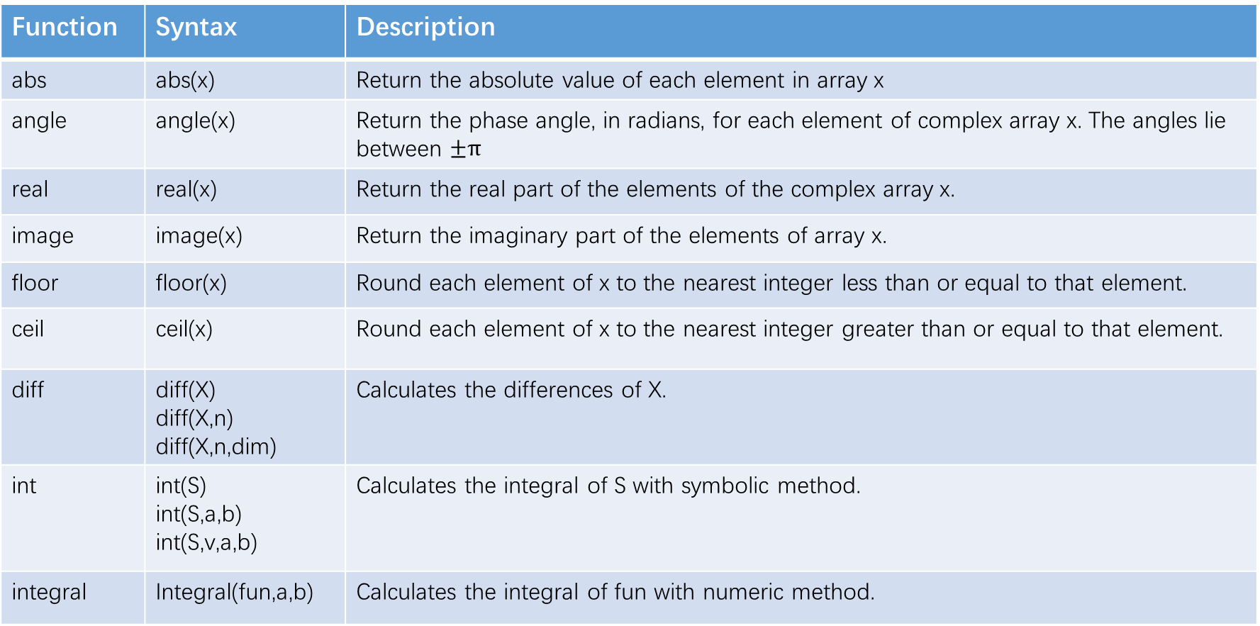
Signal Operation
Function | Syntax | Description
abs | abs(x) | Return the absolute value of each element in array x
angle | angle(x) | Return the phase angle, in radians, for each element of complex array x. The angles lie between $±π$
real | real(x) | Return the real part of the elements of the complex array x.
image | image(x) | Return the imaginary part of the elements of array x.
floor | floor(x) | Round each element of x to the nearest integer less than or equal to that element.
ceil | ceil(x) | Round each element of x to the nearest integer greater than or equal to that element.
diff | diff(X) diff(X,n) diff(X,n,dim) | Calculates the differences of X.
int | int(S) int(S,a,b) int(S,v,a,b) | Calculates the integral of S with symbolic method.
integral | Integral(fun,a,b) | Calculates the integral of fun with numeric method.

Slide 14


Program Structure
Sequential, Loop, Branch
Loop structure
Notes:
MATLAB的成簇结构主要包括顺序结构、循环结构、分支结构等。
这里我们需要注意的是各种结构的格式。

Slide 15
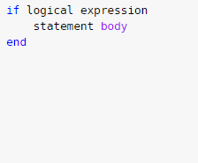
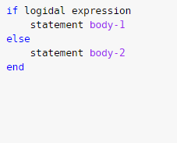
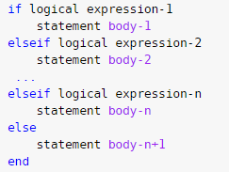
Program Structure
Branch structure
If-else-end

Slide 16
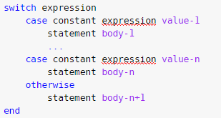
Program Structure
Branch structure
Switch

Slide 17
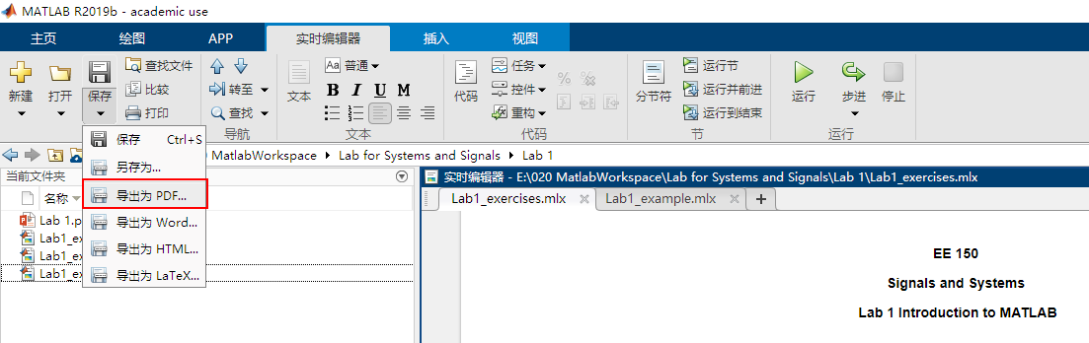
Requirements for report
Export .mlx as PDF. Do not use save as…
Check your PDF to make sure the content is completely displayed;
Name the PDF as ‘Lab1-Mon/Tue/Wed/Thir-105/107-Name-Id”;
Make sure your name and ID on the first page of the report are correct.

Slide 18
Requirements for plot
Pay attention to the label of horizontal and vertical axis. Make sure that the unit is correct.
When there are multiple signals in a picture, they should be marked separately；
To show your conclusion accurately, set a reasonable display range；
Please follow the indication to organize the format of subplot；
When there is a comparison relationship between multiple pictures, please make sure to set the same display range for them；

